Slide 1


Slide 2



Welcome
Email
Password
Sign in
You don’t have any accounts? Create one!
Eng – Viet Dictionary

Slide 3



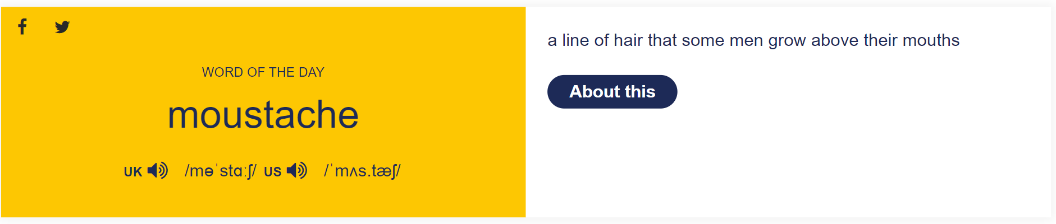


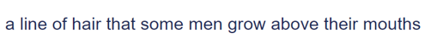
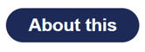
English – Vietnamese Learner’s Dictionary
Username
Search
nếu click vào x thì sẽ nhảy vào phần tra từ điển (như slide dưới)
nếu click vào about this thì sẽ tra từ này và hiện nó ra ở scene như slide dưới

Slide 4
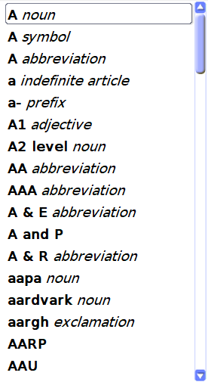

English – Vietnamese Learner’s Dictionary
Username
Search words
Index
Search something

Slide 5
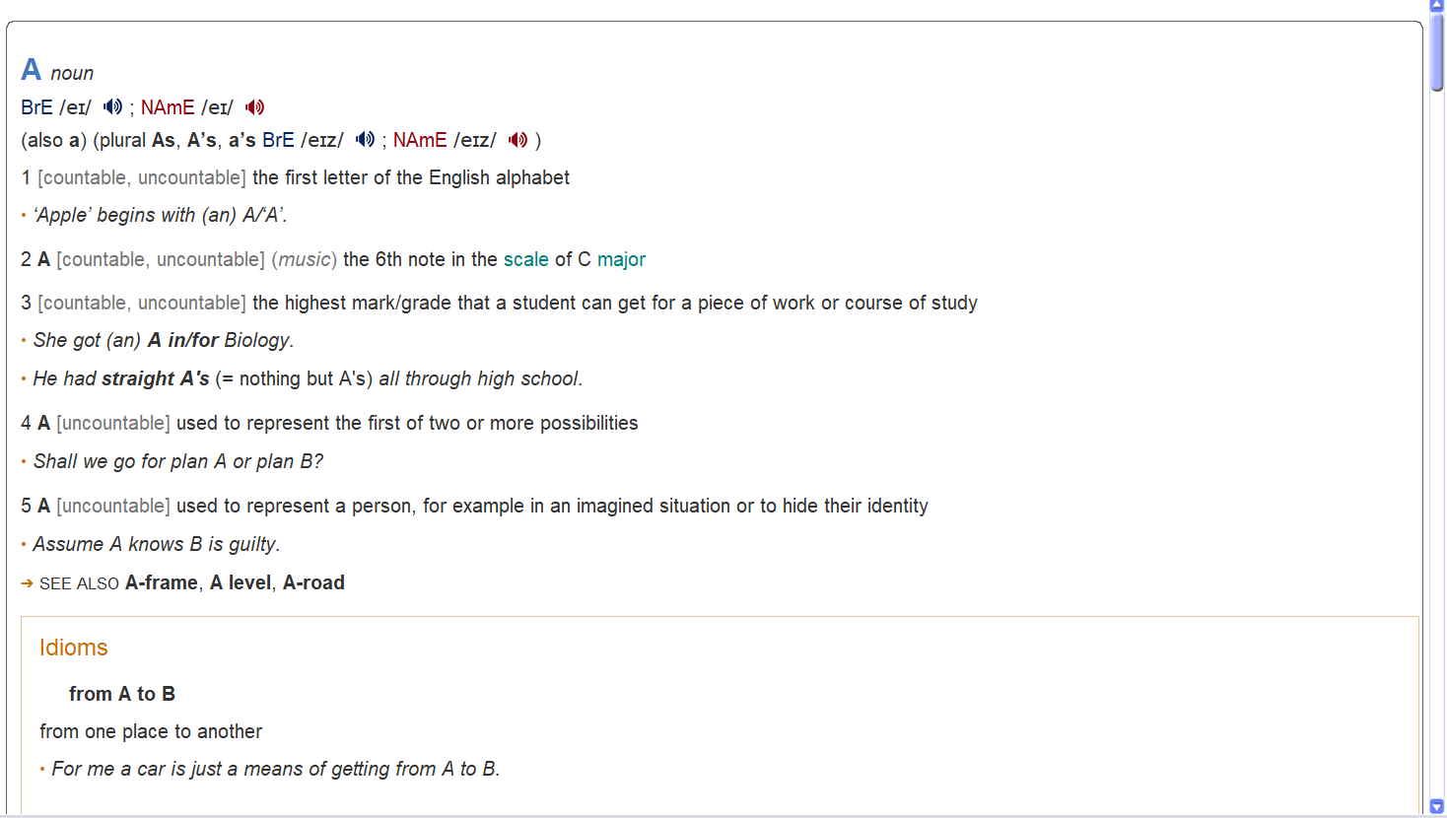

English – Vietnamese Learner’s Dictionary
Username
A
Index

Slide 6
English – Vietnamese Learner’s Dictionary
Username
A
Index
Edit options
Redefinition
Delete

Slide 7
English – Vietnamese Learner’s Dictionary
Username
Redefinition words
A
Index
A
Edit options
Parts of speech
noun
Redefinition
Delete
BrE IPA
/ei/
NAmE IPA
/ei/
Meaning
Discard changes
Save

Slide 8
English – Vietnamese Learner’s Dictionary
Username
Search
Welcome Username!
Index
Sign out

Slide 9

English – Vietnamese Learner’s Dictionary
Username
A
Index

Slide 10







English – Vietnamese Learner’s Dictionary
Username
MENU
Search
Home
Index
Saved word
Translate Online
Add new words
Game
Settings
Information

Slide 11
English – Vietnamese Learner’s Dictionary
Username
MENU
Search
Home
Index
Saved word
Translate Online
Add new words
Game
Settings
Information

Slide 12

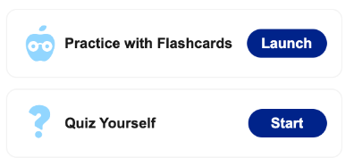
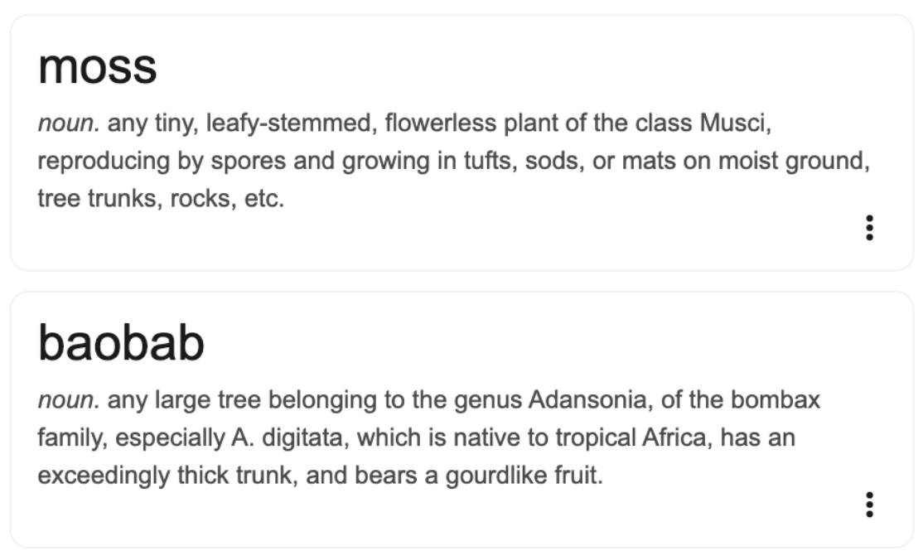
English – Vietnamese Learner’s Dictionary
Username
Search saved words
Saved Words

Slide 13
English – Vietnamese Learner’s Dictionary
Username
MENU
Search
Home
Index
Saved word
Translate Online
Add new words
Game
Settings
Information

Slide 14

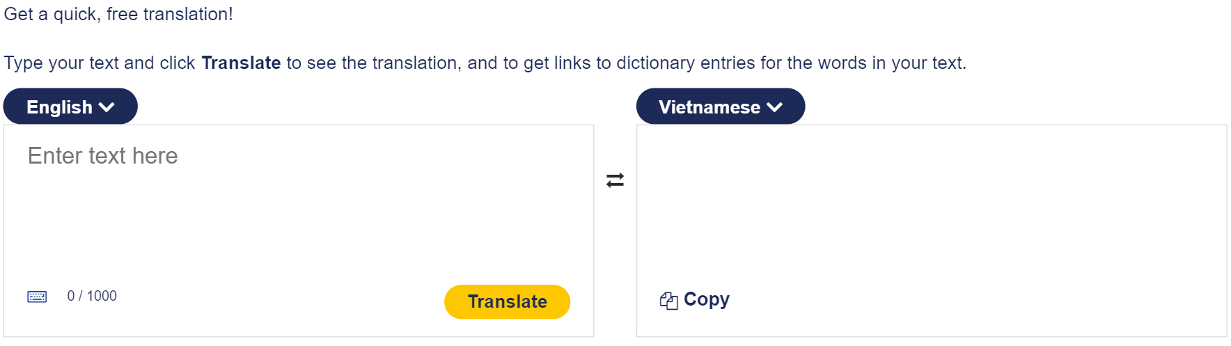


English – Vietnamese Learner’s Dictionary
Username
Online Translator

Slide 15
English – Vietnamese Learner’s Dictionary
Username
MENU
Search
Home
Index
Saved word
Translate Online
Add new words
Game
Settings
Information

Slide 16
English – Vietnamese Learner’s Dictionary
Username
Add new words
A
Parts of speech
noun
BrE IPA
/ei/
NAmE IPA
/ei/
Meaning
Discard changes
Save

Slide 17
English – Vietnamese Learner’s Dictionary
Username
MENU
Search
Home
Index
Saved word
Translate Online
Add new words
Game
Settings
Information

Slide 18



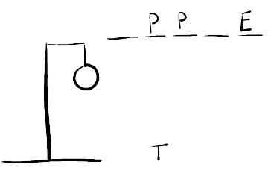
English – Vietnamese Learner’s Dictionary
Username
Game
Advanced your vocabulary with our games and quizzes.
Practice with Flashcard
Launch
Multiple Choices
Launch
Hangman
Launch

Slide 19
English – Vietnamese Learner’s Dictionary
Username
MENU
Search
Home
Index
Saved word
Translate Online
Add new words
Game
Settings
Information

Slide 20
English – Vietnamese Learner’s Dictionary
Username
Settings
User settings
Text size
⃝ Small
⃝ Medium
⃝ Large
⃝ Very Large
Application settings
Text size
Automatic Sound
Theme
User settings
Change password
Delete account

Slide 21
English – Vietnamese Learner’s Dictionary
Username
Settings
User settings
Automatic Sound
⃝ Men
⃝ Woman
Application settings
Text size
Automatic Sound
Theme
User settings
Theme
Change password
⃝ Light
⃝ Dark
Delete account

Slide 22
English – Vietnamese Learner’s Dictionary
Username
Settings
User settings
Theme
⃝ Light
⃝ Dark
Application settings
Text size
Automatic Sound
Theme
User settings
Change password
Delete account

Slide 23
English – Vietnamese Learner’s Dictionary
Username
Settings
User settings
Change password
Application settings
Current password
New password
Confirm new password
Text size
Automatic Sound
Theme
User settings
Change password
Delete account

Slide 24
English – Vietnamese Learner’s Dictionary
Username
Settings
User settings
Delete account
Please enter your account information to continue:
Application settings
Email
Username
Password
Text size
Automatic Sound
Theme
User settings
Change password
Delete account
Next

Slide 25
English – Vietnamese Learner’s Dictionary
Username
Settings
User settings
Delete account
Please enter your account information to continue:
Warning
Application settings
Email
Username
Password
Text size
Automatic Sound
Once you confirm delete your account, all of your data will be lost. Do you want to continue?
Theme
User settings
Back
Confirm
Change password
Delete account
Next

Slide 26
English – Vietnamese Learner’s Dictionary
Username
Settings
User settings
Delete account
Please enter your account information to continue:
Application settings
Notification
Email
Username
Password
Text size
Automatic Sound
Your account is deleted successfully!
Theme
Okay
User settings
Change password
Delete account
Next

Slide 27
Welcome
Email
Password
Sign in
You don’t have any accounts? Create one!
Eng – Viet Dictionary

